Slide 1
Tips for Creating Better PowerPoint Presentations
Part 1

Slide 2



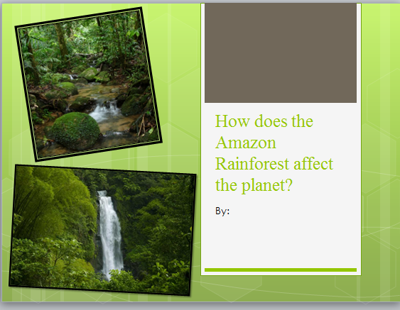
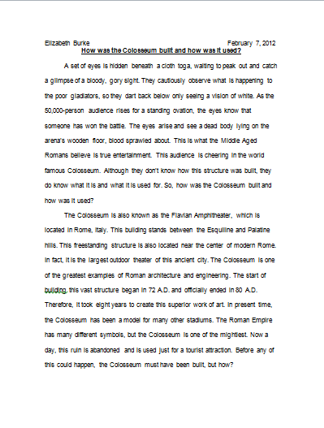
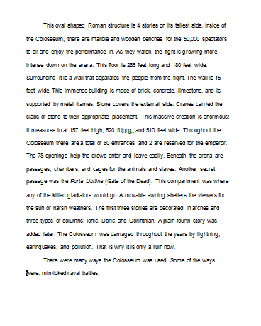
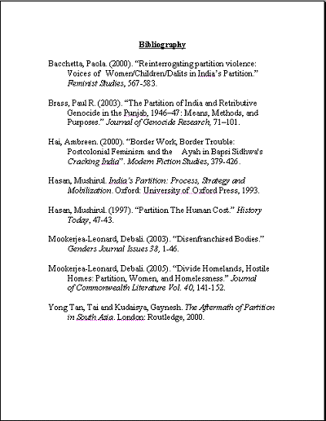


?
How does the Amazon Rainforest affect the planet?
Notes:
Review what the 6th Grade Assessment contains:
A question: The students explore topics related to the K-6 Central Bucks School District curriculum and locate resources that can be used to research the topics. After selecting one (or two) topics, the students develop researchable questions.
Research tied to the question: The students spend time in the library researching, using graphic organizers, and taking notes in order to write a research paper that answers their research question.
A paper: The students use the writing process (drafting, revising and editing, and publishing) to produce a word processed research paper that is scored by at least two educators
A presentation: The students create a multimedia visual which they use during a presentation to at least two adult educators.​

Slide 3

Notes:
Show students the rubric in the form of a word cloud. Word clouds can help involve students in identifying and learning the key vocabulary in the rubric. The larger words are used more frequently. You could print the word cloud or project it. Ask students to explain the key words they see and what they mean.

Slide 4
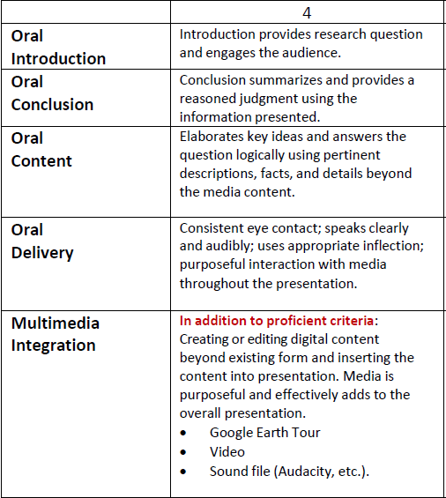
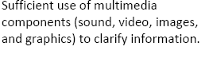


The Rubric
Notes:
Ask students to highlight keys words in the rubric and then guide them to finding important terms.

Slide 5
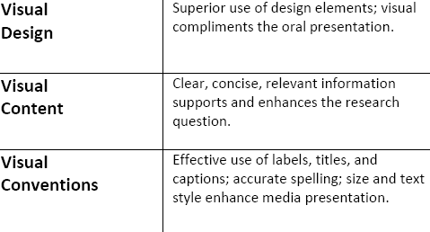
The Rubric
Elaborate
Enhance
Purposeful
Notes:
Ask students to highlight keys words in the rubric and then guide them to finding important terms. Explain that three words that are very important are: elaborate, enhance, and purposeful. Define the meaning of these words.

Slide 6



Notes:
Explain that while making your presentation, you want to engage the audience, elaborate your ideas (not read them) and be consistent with your design.

Slide 7





Notes:
Some techniques to use while presenting to help with engagement, elaboration and consistency are these 5 listed.

Slide 8
Notes:
Run this slide show. It has narration for the first 3 slides to give students an example of how elaboration can look and sound. Each slide should run automatically.

Slide 9
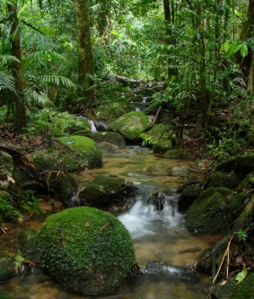

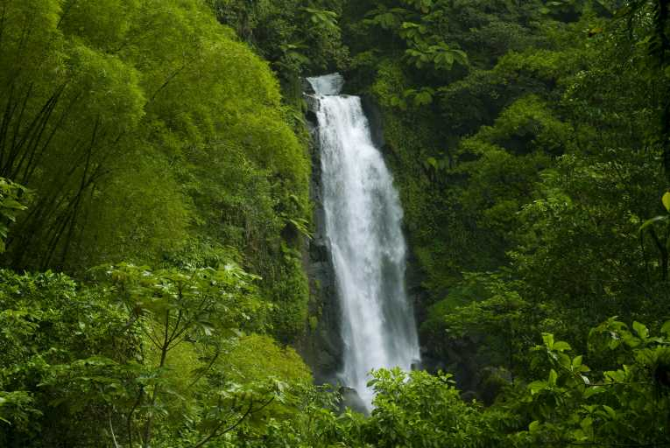

How does the Amazon Rainforest affect the planet?
By:
Notes:
Have students listen to and then discuss the introduction.

Slide 10
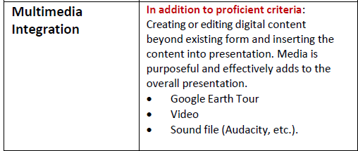
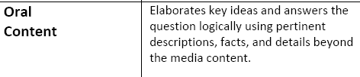
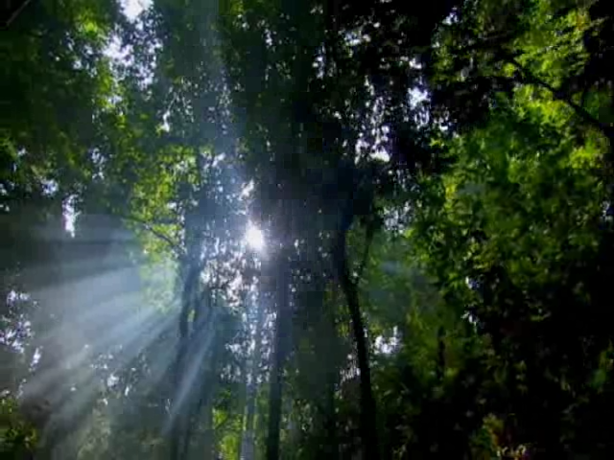
Notes:
This slide models elaboration. The presenter speaks over a silent video. The rubric states Discovery Learning and the rubric will be changed this year.

Slide 11
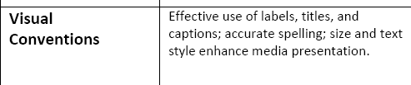
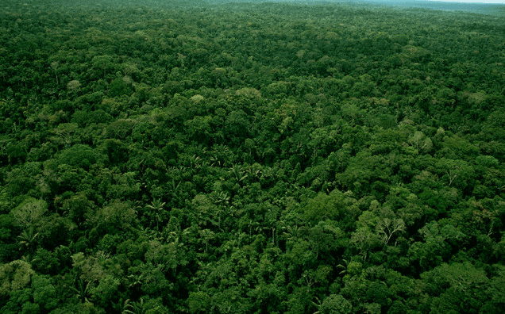
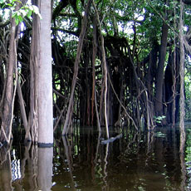

Trees and Plants
Over eighteen thousand different plants
Forest floor gets 1% sunlight
Taller the tree, longer life
One of biggest natural resources
Holds rare trees and plants

Slide 12
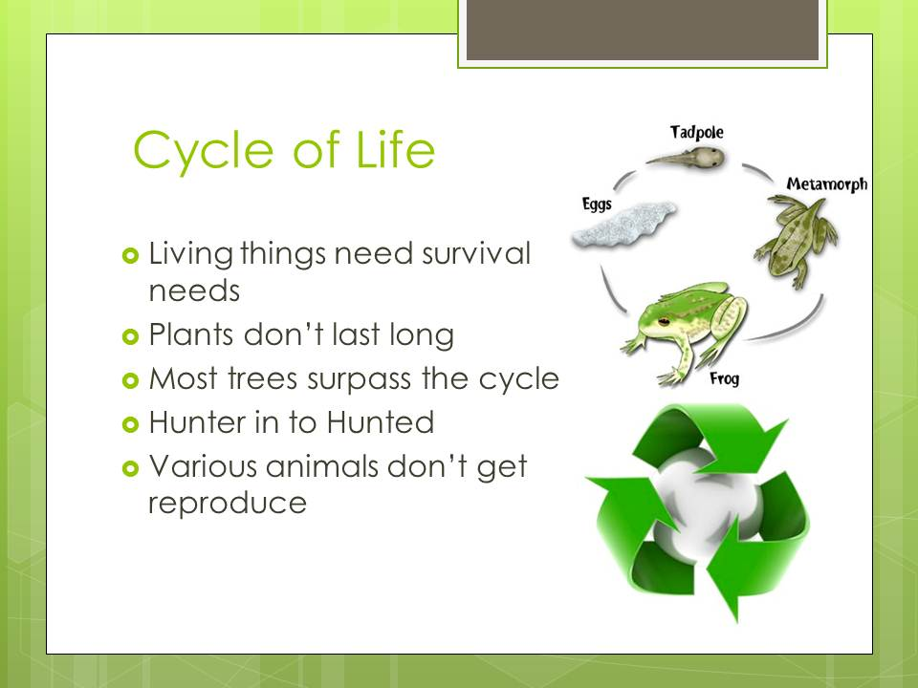
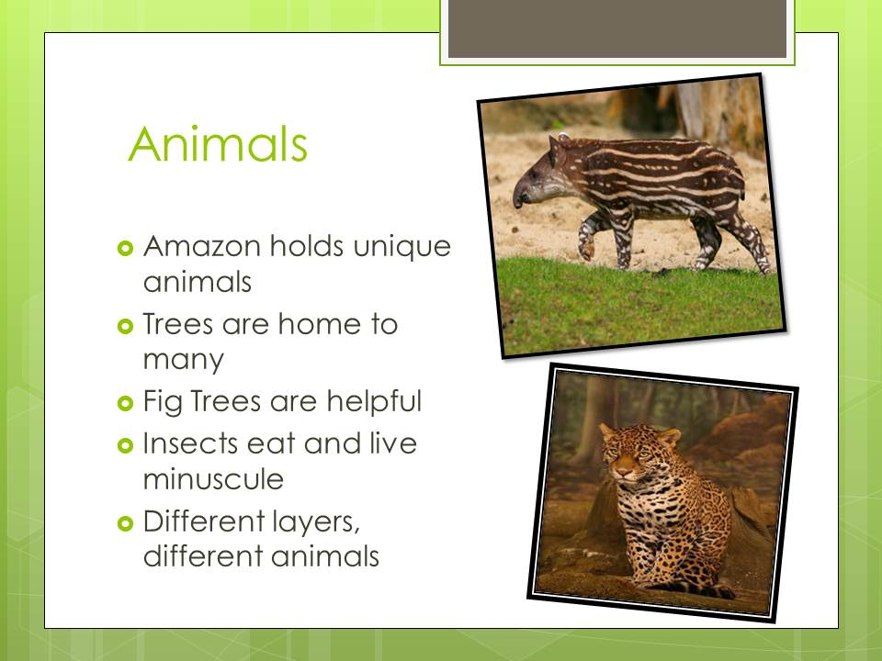
Notes:
These are screen shots of the rest of the PowerPoint to show the presentation. It shows consistency by using the same colors, fonts and backgrounds.

Slide 13
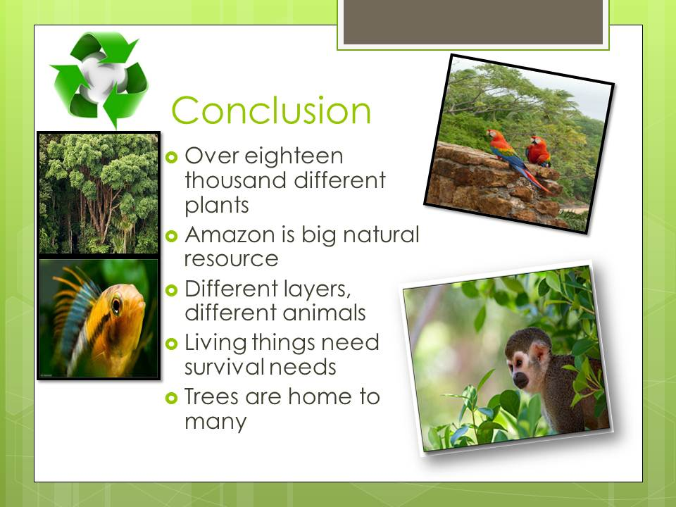
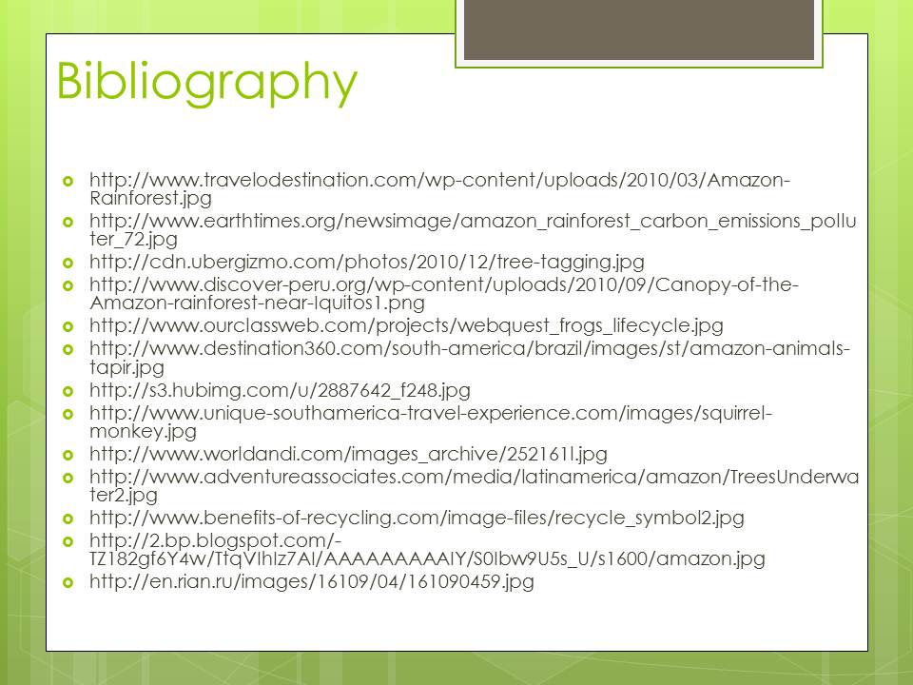

Slide 14
How can you be sure to use these three techniques? What are some strategies?
Notes:
Cycle back to these three techniques. Based on the what students just watched about the rainforest, ask students to think of tools and techniques that can help engage, elaborate, and model consistency. Some tools are found on the next slide.

Slide 15


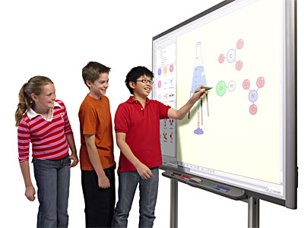
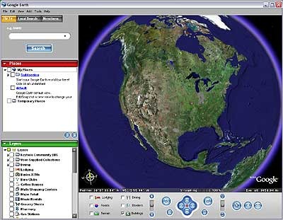


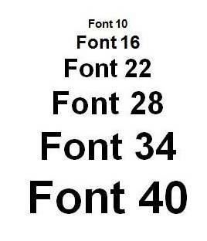

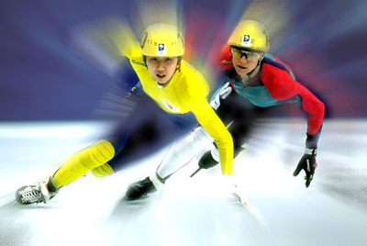
Images
Concise
Interact
Maps
Backgrounds
Multimedia
Text
Colors
Motion
Notes:
Talk about ways to help make an engaging presentation. This could be used as a student handout. You can print this slide for them. It is in the Download All Handout links found on http://www.cbsd.org/Page/16771.

Slide 16



Notes:
Ask students to classify each technique into one of three categories. You may want to give students slide 15 as a key.

Slide 17
1
5
6
2
3
7
4
8
Notes:
This slide is used to model where Font would be placed. It could be placed in any of the three sections but the best location is consistent design. Allow time for students to persuade you why it should go into other categories using language from the rubric.

Slide 18

1
5
6
2:00
2
1:59
1:58
1:57
1:56
1:55
1:54
1:53
1:52
1:51
1:50
1:49
1:48
1:47
1:46
1:45
1:44
1:43
1:42
1:41
1:40
1:39
1:38
1:37
1:36
1:35
1:34
1:33
1:32
1:31
1:30
1:29
1:28
1:27
1:26
1:25
1:24
1:23
1:22
1:21
1:20
1:19
1:18
1:17
1:16
1:15
1:14
1:13
1:12
1:11
1:10
1:09
1:08
1:07
1:06
1:05
1:04
1:03
1:02
1:01
1:00
0:59
0:58
0:57
0:56
0:55
0:54
0:53
0:52
0:51
0:50
0:49
0:48
0:47
0:46
0:45
0:44
0:43
0:42
0:41
0:40
0:39
0:38
0:37
0:36
0:35
0:34
0:33
0:32
0:31
0:30
0:29
0:28
0:27
0:26
0:25
0:24
0:23
0:22
0:21
0:20
0:19
0:18
0:17
0:16
0:15
0:14
0:13
0:12
0:11
0:10
0:09
0:08
0:07
0:06
0:05
0:04
0:03
0:02
0:01
End
2:00
3
7
4
8
Notes:
Give students 2 minutes to minutes to place each element into a category. By using the numbers on each line the process will go smoother. Students could have this sheet in front of them. It is in the All Handouts Link found here: http://www.cbsd.org/Page/16771.

Slide 19
1
5
8
2
6
7
4
3
Notes:
This is the answer key but there is room for debate as many answers overlap.

Slide 20
Tips for Creating Better PowerPoint Presentations
Part 2
Notes:
This could be done in the same day as part 1 or this could be a mini-lesson for day 2.

Slide 21
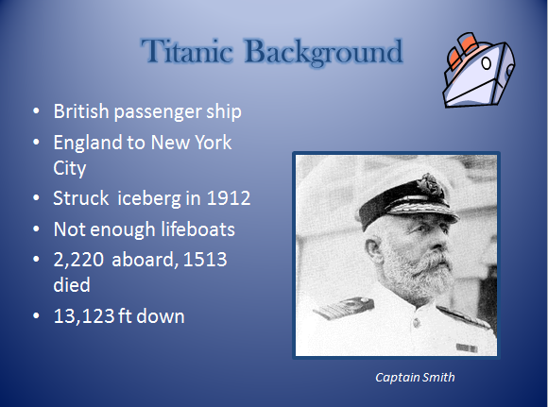
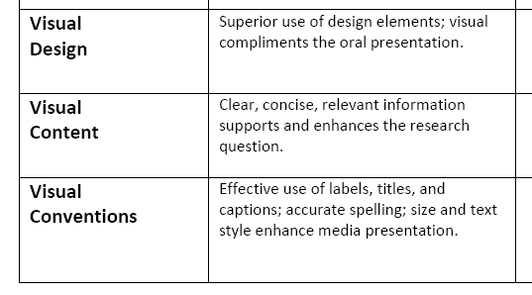
Notes:
Have students look at this slide and grade the three categories shown. Students should see the clip art does not fit, the image is not relevant and there is a lot of text. Ask if they could make it better or how they could enhance the visual design. You could try the photo analysis activity to practice using relevant images: http://www.cbsd.org/Page/16917.

Slide 22
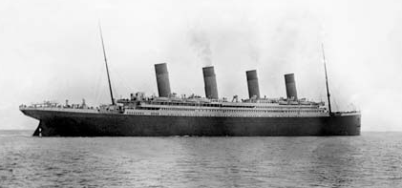
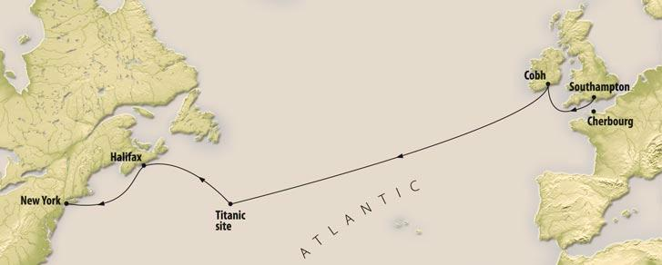
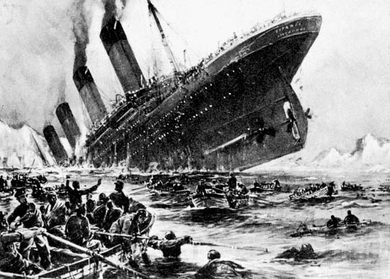
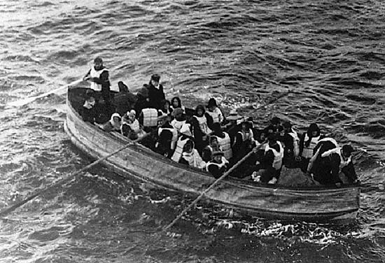
The Titanic
British Passenger Ship
Traveling from England
Struck an Iceberg
Lifeboat Supply Limited
Notes:
This slide is hidden. You could use this to show how to add relevant images.

Slide 23

2:00
1:59
1:58
1:57
1:56
1:55
1:54
1:53
1:52
1:51
1:50
1:49
1:48
1:47
1:46
1:45
1:44
1:43
1:42
1:41
1:40
1:39
1:38
1:37
1:36
1:35
1:34
1:33
1:32
1:31
1:30
1:29
1:28
1:27
1:26
1:25
1:24
1:23
1:22
1:21
1:20
1:19
1:18
1:17
1:16
1:15
1:14
1:13
1:12
1:11
1:10
1:09
1:08
1:07
1:06
1:05
1:04
1:03
1:02
1:01
1:00
0:59
0:58
0:57
0:56
0:55
0:54
0:53
0:52
0:51
0:50
0:49
0:48
0:47
0:46
0:45
0:44
0:43
0:42
0:41
0:40
0:39
0:38
0:37
0:36
0:35
0:34
0:33
0:32
0:31
0:30
0:29
0:28
0:27
0:26
0:25
0:24
0:23
0:22
0:21
0:20
0:19
0:18
0:17
0:16
0:15
0:14
0:13
0:12
0:11
0:10
0:09
0:08
0:07
0:06
0:05
0:04
0:03
0:02
0:01
End
2:00
Notes:
This slide is also hidden. But it could be used with the image analysis activity. http://www.cbsd.org/Page/16917. What can students infer from this image. Is it a good image to use about the Titanic? Why or why not??

Slide 24
Notes:
We are no going to watch a newscast. Good newscasters use lots of techniques to engage the audience. Watch this video looking for video clips, images, maps and graphics. Notice how much text is used.
This slide should run on its own. The volume is low so you can talk about the rubric as it runs.

Slide 25

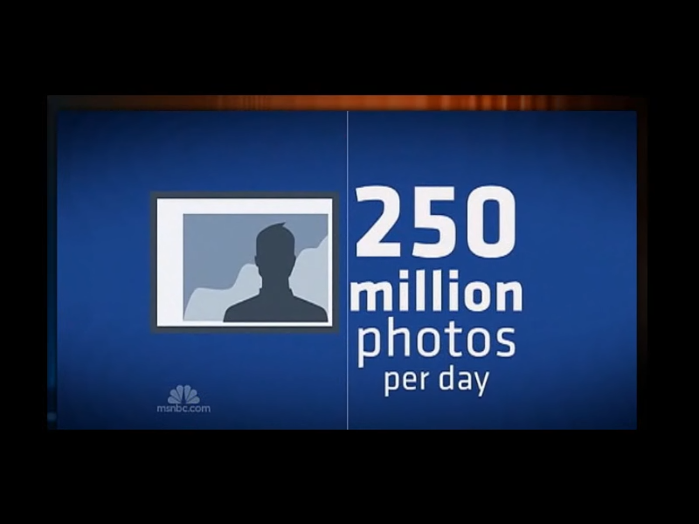
Notes:
We are no going to watch a newscast. Good news casters use lots of techniques to engage the audience. This slide should run on its own. The volume is low so you can talk about the rubric as it runs.

Slide 26
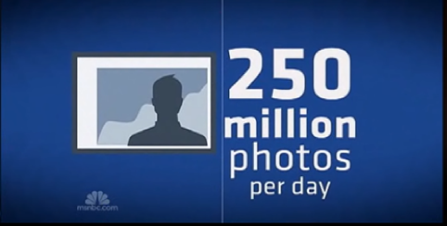
Notes:
Summarize what you saw in the newscast. You could watch the video twice if time allows. Once to absorb it and once to critique it.

Slide 27
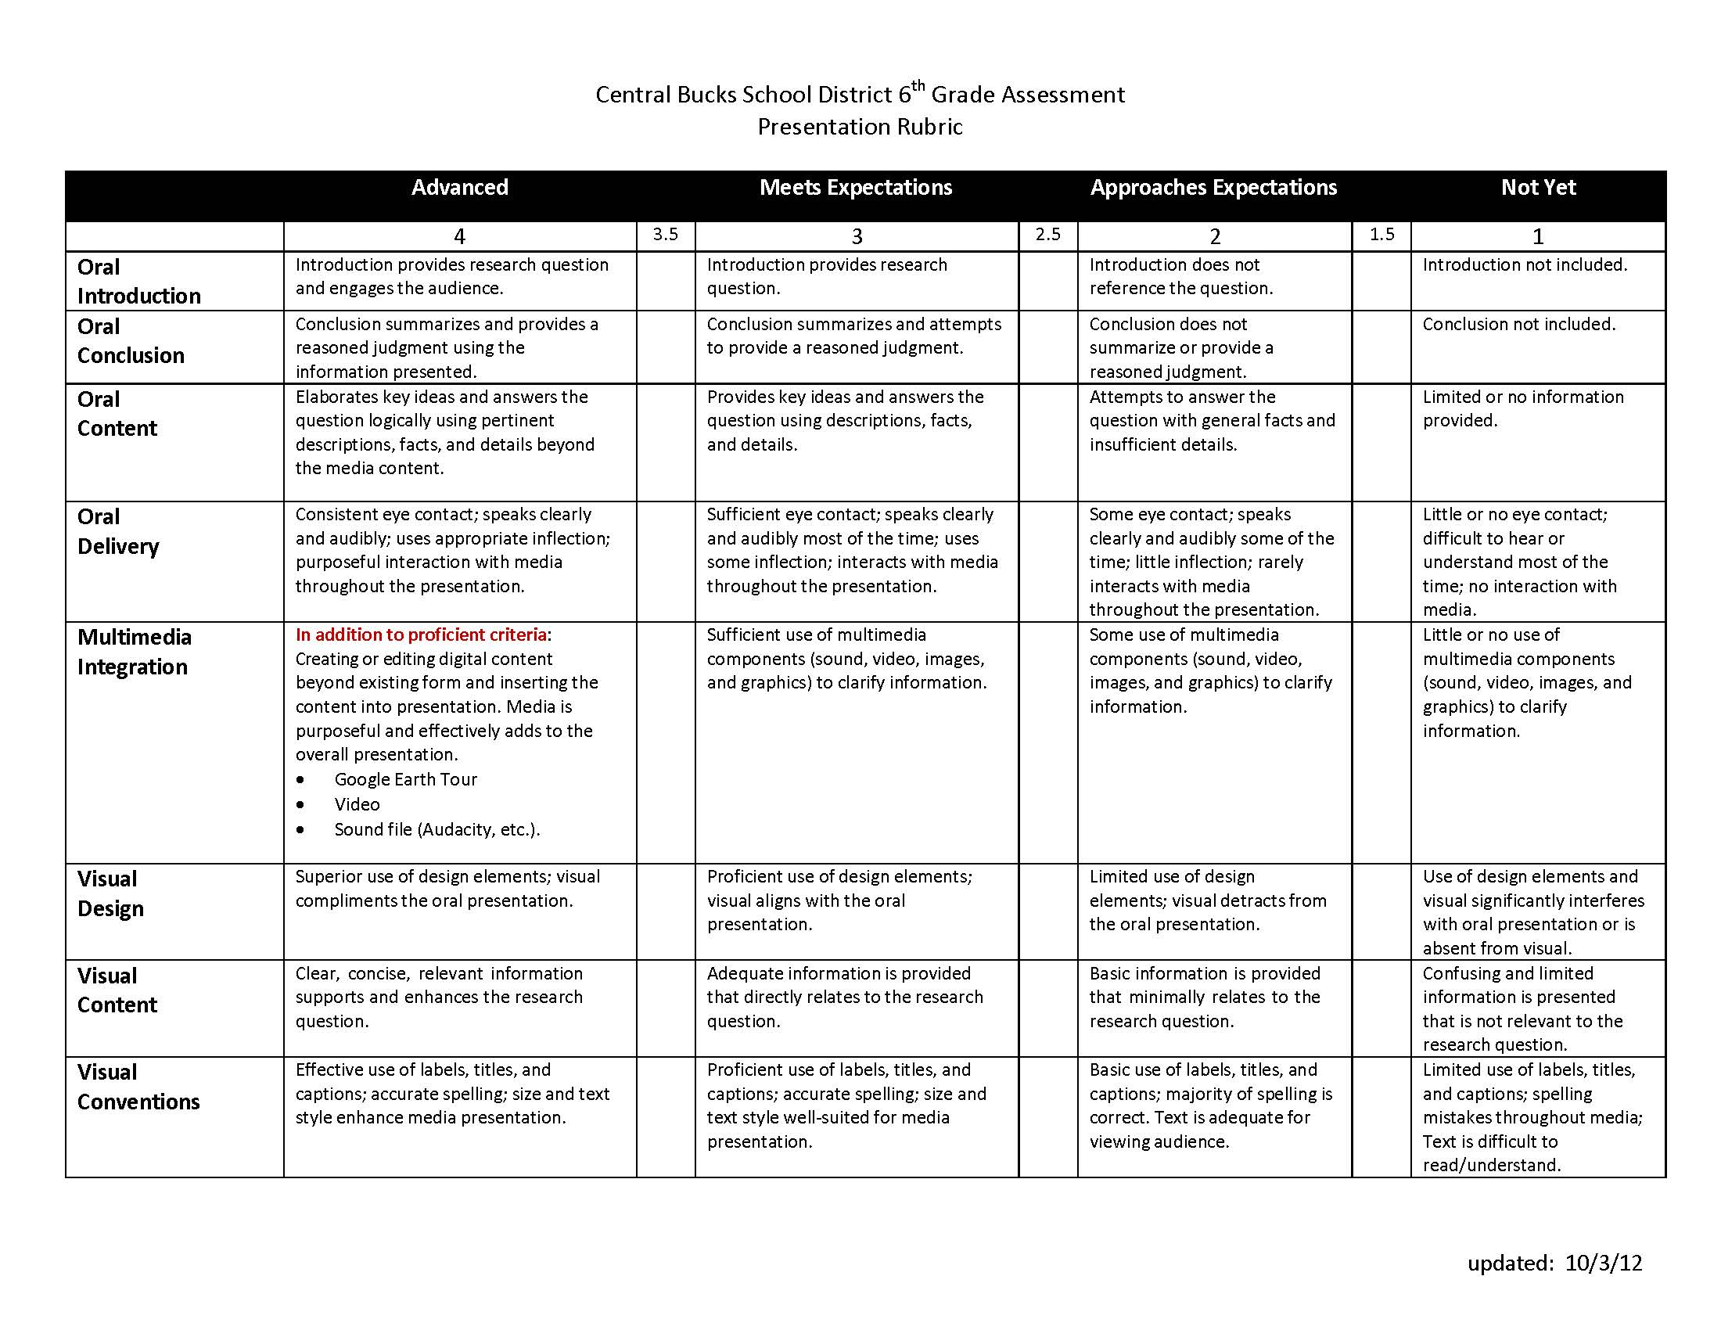
Notes:
Grade a PowerPoint. Run through the PowerPoint on slides 26-37 and then have students grade the presentation. Teachers should speak about each slide referring to the rubric as well as design elements. I placed very brief notes on each page to allow you to interpret this how you see fit.

Slide 28
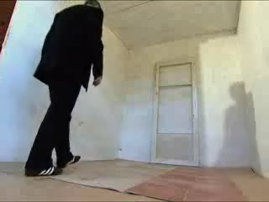
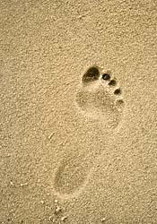
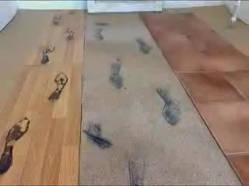
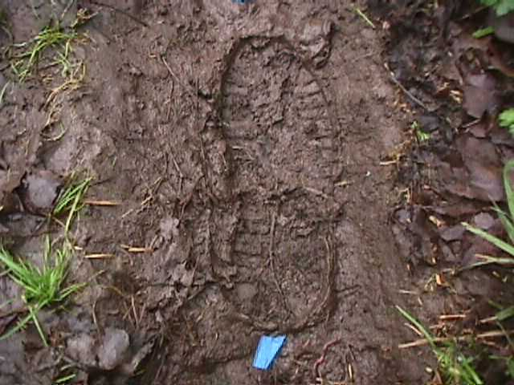

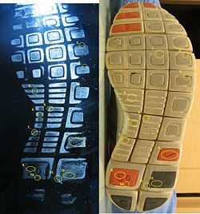
How does the FBI use footprints to catch perpetrators?
Notes:
Question stated. Lots of relevant images.

Slide 29
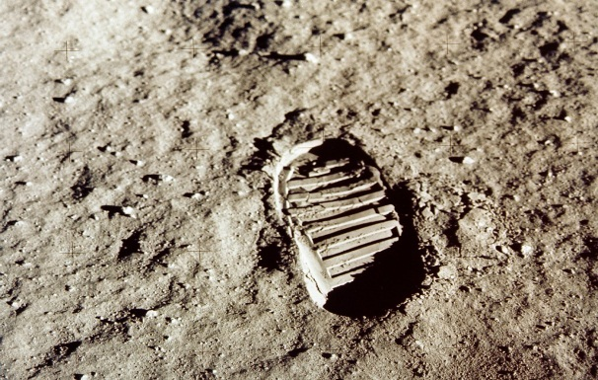
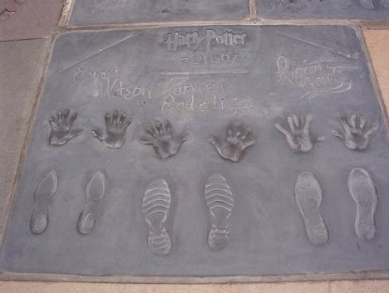
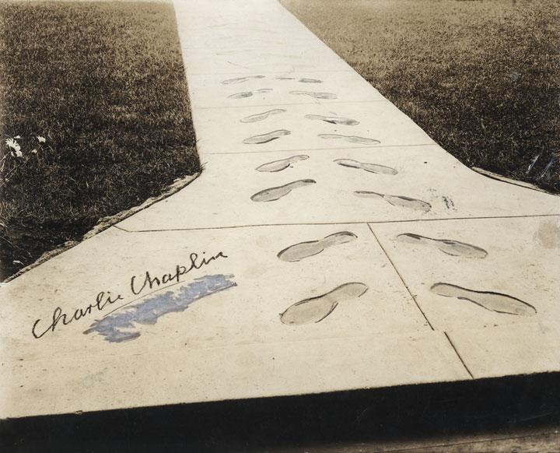
Can you catch a perpetrator?
Notes:
Hidden Slide

Slide 30
Can you catch a perpetrator?
Charlie Chaplin
Neil Armstrong
Harry Potter
Notes:
Hidden Slide

Slide 31

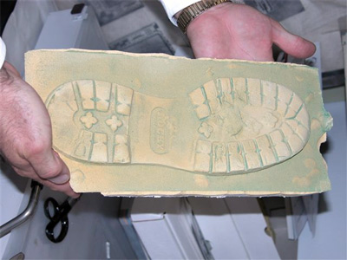
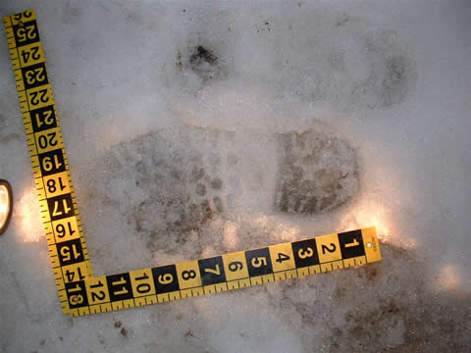
How does the FBI use footprints to catch perpetrators?
Forms of Footwear Impressions
Information from Impressions
The Examination Process
Notes:
Three subtopics.

Slide 32
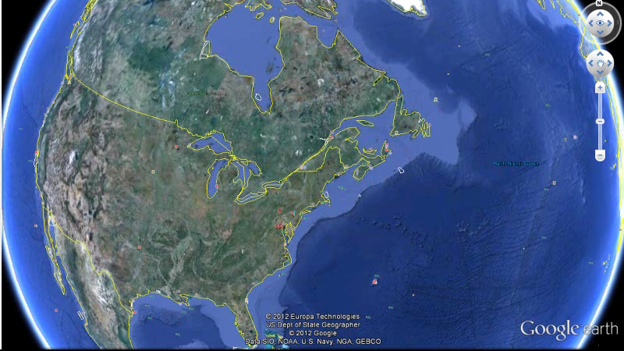
Location FBI
Notes:
A Google earth example. Directions on how to do this are in Day 6 Activity Sheet. http://www.cbsd.org/Page/16771

Slide 33
Forms of Footwear Impressions
Three Dimensional
Sand
Mud
Snow
Two Dimensional
Wood/Paper
Glass
Carpet
Notes:
Visual SmartArt. Room for elaboration.

Slide 34
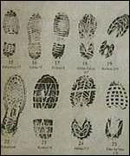
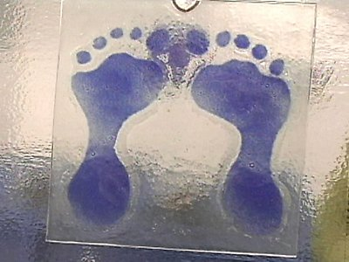
Forms of Footwear Impressions

Slide 35
Information from Footwear Impressions
Number of perpetrators?
  Tracking
Determination of Shoe Size
Identification of Footwear ?
  Association with Other Evidence
Notes:
Using the pen tool students could draw on the slide. You can right click the mouse to see the pen features.

Slide 36
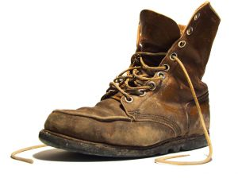
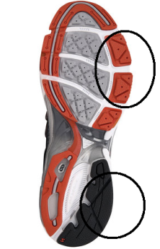
The Examination Process
Look at the Physical Size and Shape
Step 1
Step 2
Step 3
  Examine the Design of Shoe
  Analyze Wear Marks
Notes:
Timelines show content in a visual format. Timeline templates can be found here: http://goo.gl/q5Fqa1

Slide 37
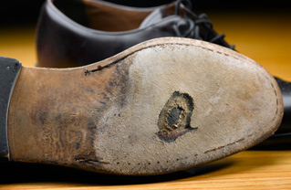
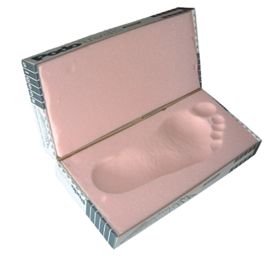
  Look For Individual Identifying Characteristics- cuts, tar, gum..etc
Compare Impression with Suspects Footwear
Step 4
Step 5
Step 6
Examiner Makes Impressions

Slide 38
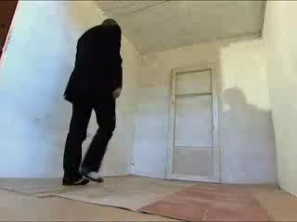
Examination Process Duration~0:35
Notes:
Short video clips that are relevant. You do not need sound. This clip is muted so students can elaborate over the slide.

Slide 39
How does the FBI use footprints to catch perpetrators?
Forms of Footwear Impressions
Information from Impressions
The Examination Process

Slide 40

1:30
1:29
1:28
1:27
1:26
1:25
1:24
1:23
1:22
1:21
1:20
1:19
1:18
1:17
1:16
1:15
1:14
1:13
1:12
1:11
1:10
1:09
1:08
1:07
1:06
1:05
1:04
1:03
1:02
1:01
1:00
0:59
0:58
0:57
0:56
0:55
0:54
0:53
0:52
0:51
0:50
0:49
0:48
0:47
0:46
0:45
0:44
0:43
0:42
0:41
0:40
0:39
0:38
0:37
0:36
0:35
0:34
0:33
0:32
0:31
0:30
0:29
0:28
0:27
0:26
0:25
0:24
0:23
0:22
0:21
0:20
0:19
0:18
0:17
0:16
0:15
0:14
0:13
0:12
0:11
0:10
0:09
0:08
0:07
0:06
0:05
0:04
0:03
0:02
0:01
End
1:30
Notes:
Grade the presentation. Explain that this was not a real presentation as the oral portion was paraphrased. Allow students to grade the highlighted components then discuss.

Slide 41
Reflection
http://goo.gl/ij7p6
Notes:
For homework, students can complete this survey. If you use Quia, you could copy it to your own account. Or, the results are public if you would like to use this survey. I recommend having students use first names only.

Slide 42
Part 3

Slide 43


Central Bucks School District—Elementary Technology Scope & Sequence
Grade Six Technology Portfolio Checklist Student Name: Teacher Name:
Notes:
This slide could be used when going to the lab to complete your checklist. It can be done at anytime during the school year for the portfolio conference.

Slide 44

Task 1(easy): Try to remove the white background from these images.
Notes:
Students should complete this activity in the computer lab. The need the direction sheet found at: http://www.cbsd.org/Page/16917
It is the Footprint Student PowerPoint Activity.

Slide 45

Task 2(easy): Using the Format Painter tool duplicate the style of Image 1 onto the other images.
Image 1

Slide 46

Task 3(easy): Try to duplicate Image 1 in the blue circle. You can not copy and paste.
Image 1

Slide 47


Task 4(easy): Try to draw on the images with the Pen tool.

Slide 48
Task 5(intermediate): Try to create animated triggers with the images below. Make the images the trigger.

Slide 49
Task 6(intermediate): Change the bulleted list into a graphic organizer using SmartArt.
  The following information may be obtained from footwear impressions:
  Identification of Footwear
  Elimination of Footwear
  Participation of suspect in crime
  Location of Impressions

Slide 50
Task 7(highly advanced): Insert any video into this slide. Try to find a short clip if possible.

Slide 51

Task 8(advanced): (1) Trim this video to 30 seconds, (2) Change the first frame that is viewed using a Poster Frame.

Slide 52
Task 9 (intermediate): Try to create a timeline about any topic using the template below or insert your own timeline.
1950
1960
1970

Slide 53
1980
1990
2000

Slide 54
2010
2020
2030

Slide 55
Task 10 (highly advanced): (1) Create a scrolling text, (2) Create and trim the videos to make a header, (3) Make a title, and (4) Add footsteps sound. (Click here for a silent video tutorial.)
•Welcome to Forensics • Mr. Hensel
Forensic Footwear Evidence

Slide 56

Task 11(highly advanced): Create a Google Earth screencast and insert the video into this slide.

